Slide 1
딥러닝 이론 교육
Machine Learning to CNN
Joonhyeon Park <junpark25@ajou.ac.kr>

Slide 2
Audience
Want to understand basic machine learning (ML)
No/weak math/computer science background
Want to use ML as black-box with basic understanding
Want to use Pytorch and Python (optional)

Slide 3
Goals
Basic understanding of machine learning algorithms
Solve your problems using machine learning tools

Slide 4

AI / Machine Learning /
Deep Learning
Artificial Intelligence — Human intelligence exhibited by machines
Machine Learning — An approach to achieve artificial intelligence
A technique for implementing machine learning based on artificial deep neural network
https://blogs.nvidia.com/blog/2016/07/29/whats-difference-artificial-intelligence-machine-learning-deep-learning-ai/

Slide 5
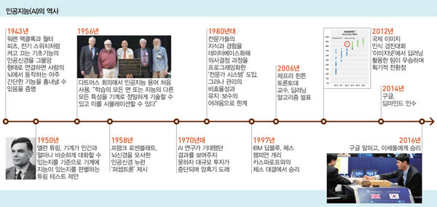
History of AI
http://weekly.khan.co.kr/khnm.html?www&mode=view&art_id=201904221341581&dept=114

Slide 6
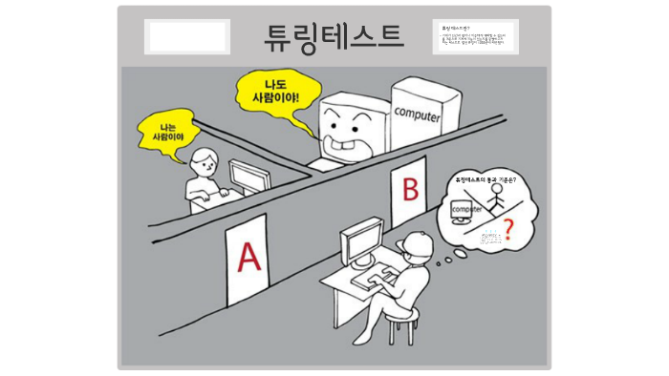
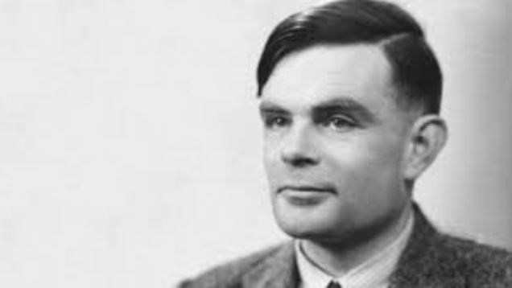
Turing Test

Slide 7
Supervised/Unsupervised Learning
Supervised learning:
- learning with labeled examples - training set

Slide 8
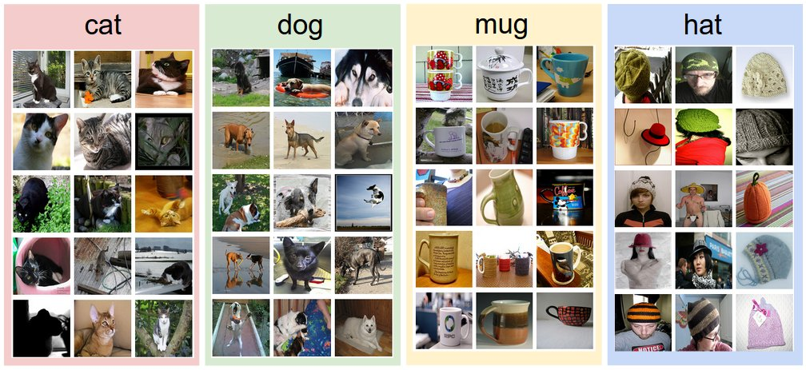
Supervised Learning
An example training set for four visual categories
https://cs231n.github.io/classification/

Slide 9
Unsupervised Learning
Supervised learning:
- learning with labeled examples - training set
Unsupervised learning: un-labeled data

Slide 10
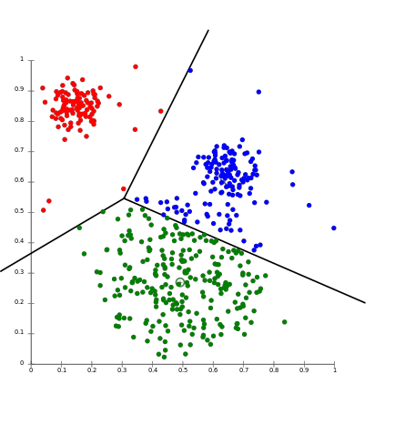
Unsupervised Learning

Slide 11
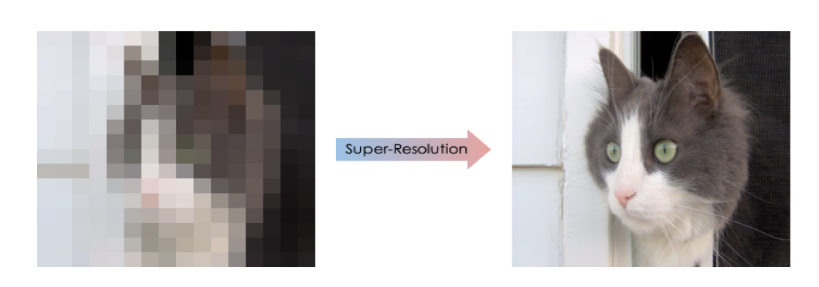
Unsupervised Learning
https://bozliu.medium.com/single-image-super-resolution-challenge-6f4835e5a156

Slide 12
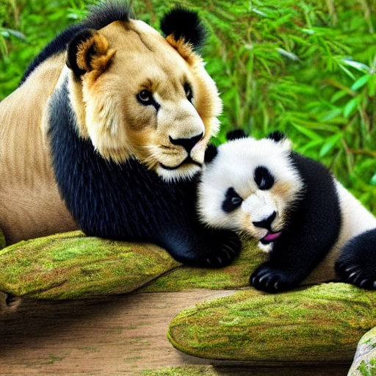
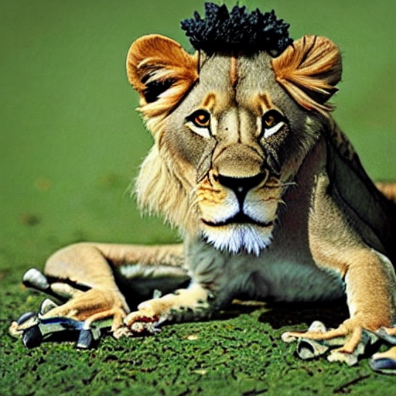
Unsupervised Learning
Lion + Panda
Lion + Frog
https://deepai.org/machine-learning-model/text2img

Slide 13
Reinforcement Learning
Supervised learning:
- learning with labeled examples - training set
Unsupervised learning: un-labeled data
Reinforcement Learning

Slide 14
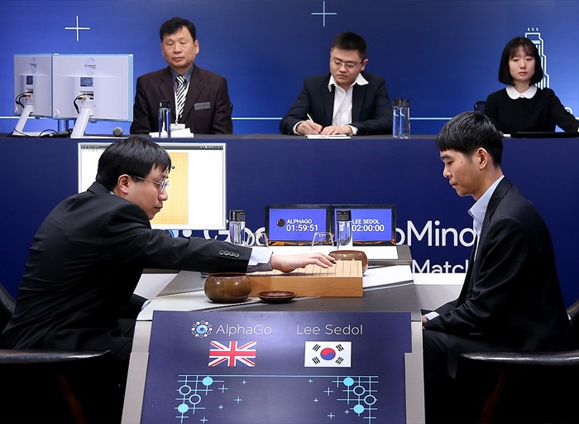
AlphaGo

Slide 15

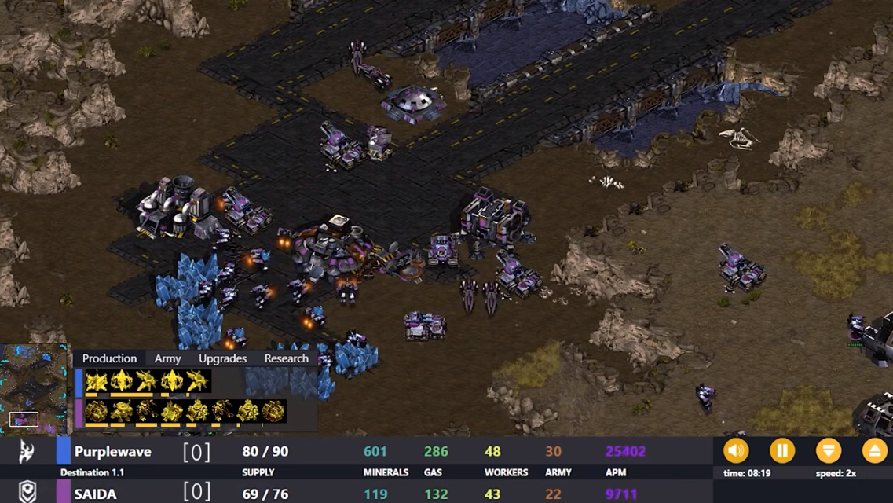
Game
Super Mario
Star Craft
https://www.youtube.com/watch?v=qv6UVOQ0F44&t=6s
https://www.youtube.com/watch?v=M-lT5E3pnDg

Slide 16
Supervised/Unsupervised Learning
Supervised Learning | Classification | kNN
 |  | Naïve Bayes
 |  | Support Vector
 |  | Machine Decision
 |  | Deep Learning
 | Regression | Linear Regression
 |  | Locally Weighted Linear
 |  | Ridge
 |  | Lasso
 |  | Deep Learning
Unsupervised Learning |  | Clustering
 |  | K Means
 |  | Density Estimation
 |  | Exception Maximization
 |  | Pazen Window
 |  | DBSCAN
 |  | Deep Learning

Slide 17
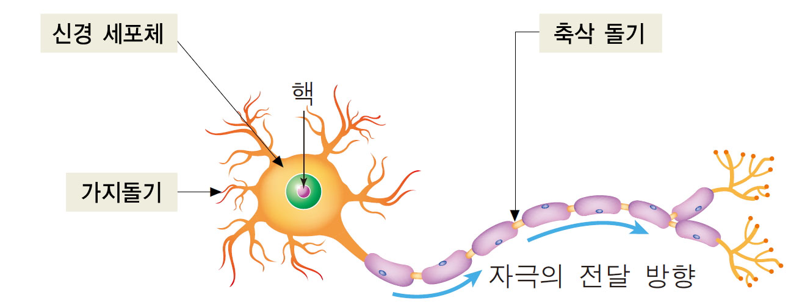
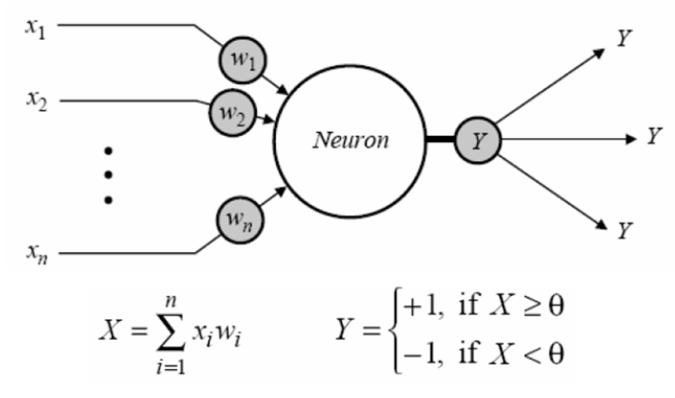
Early Neural Networks

Slide 18
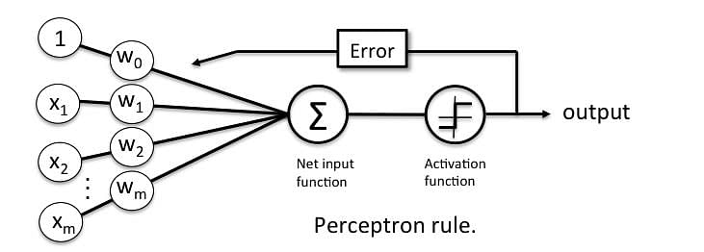
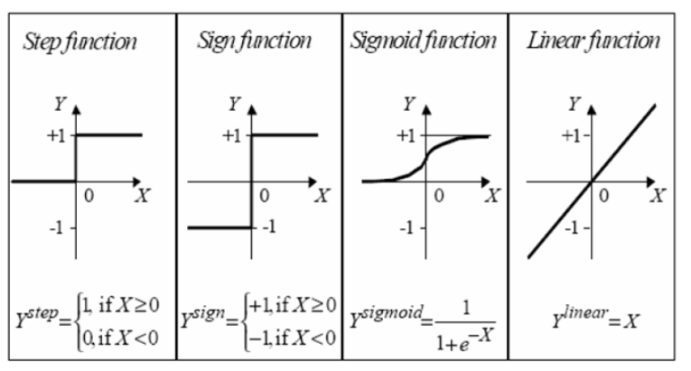
Neural Network

Slide 19
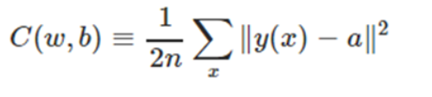
Basic Theory – Cost Function
Difference between actual and predicted values

Slide 20

Basic Theory – Gradient Descent
Iteratively trained to minimize the cost function

Slide 21
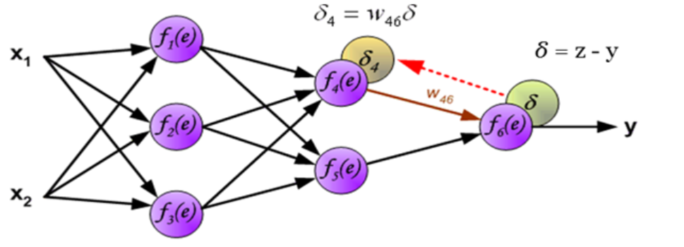
Basic Theory – Backpropagation

Slide 22
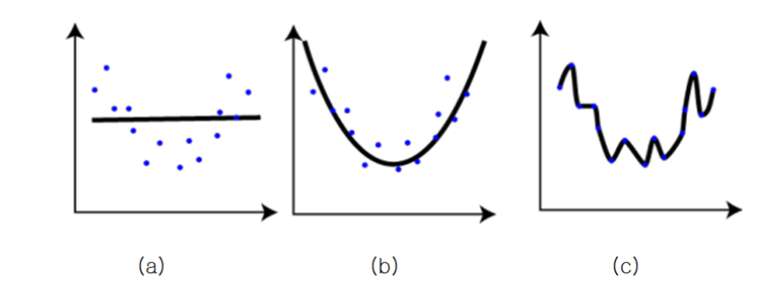
Optimization - Overfitting

Slide 23
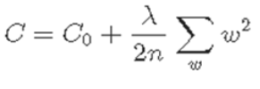
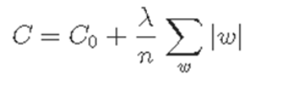
Optimization - Regularization
L2 Regularization (Weight Dacay)
L1 Regularization

Slide 24
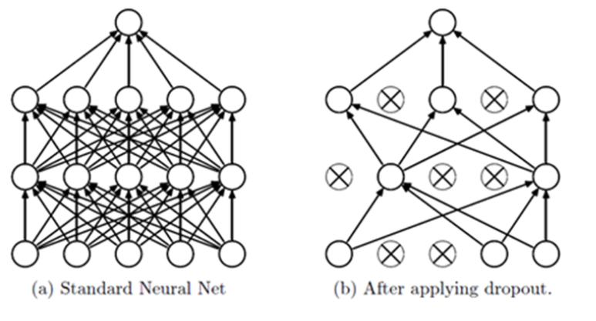
Optimization - Dropout

Slide 25
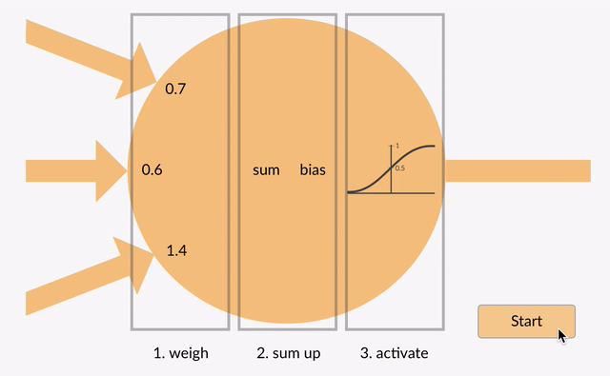
Artificial Neural Network

Slide 26
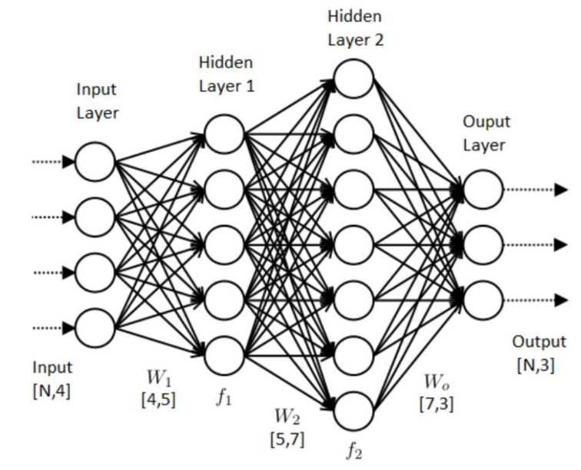
Multi-layered Neural Network

Slide 27
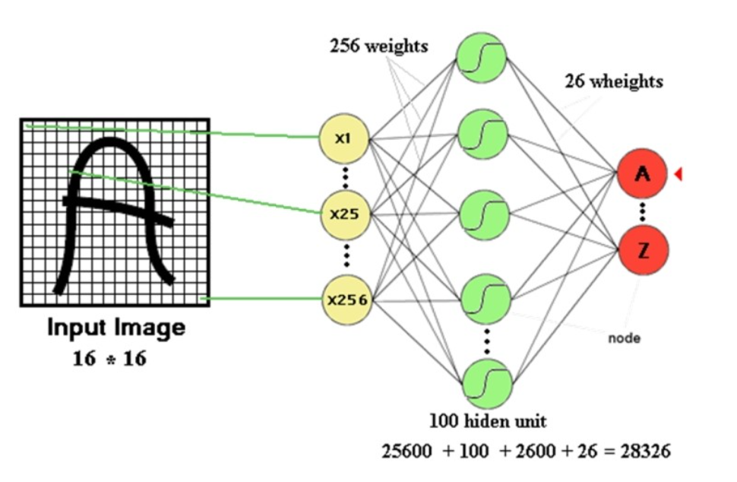
Convolution Neural Network

Slide 28
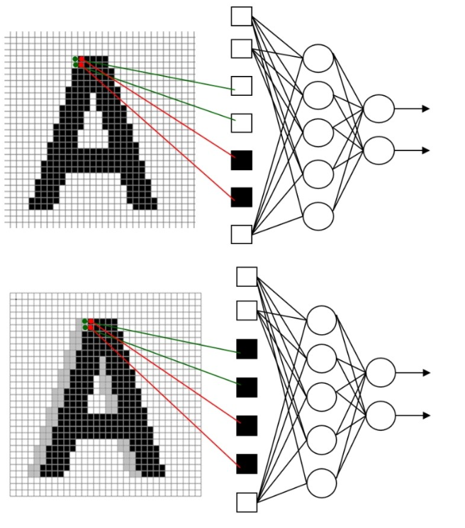

Convolution Neural Network
Problems of MLP

Slide 29
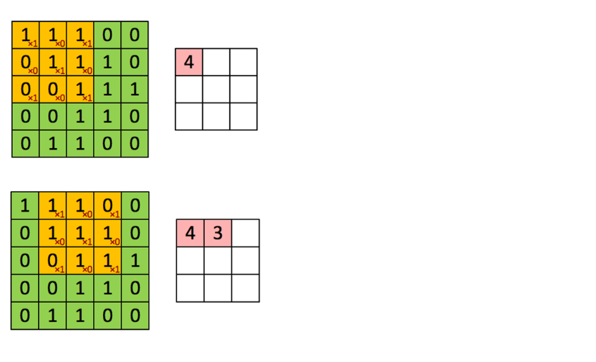
Convolution Neural Network

Slide 30

Convolution Neural Network

Slide 31
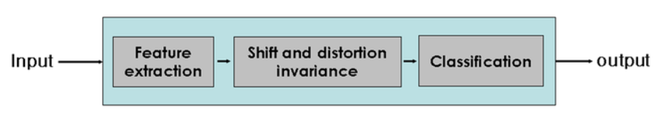
Convolution Neural Network

Slide 32
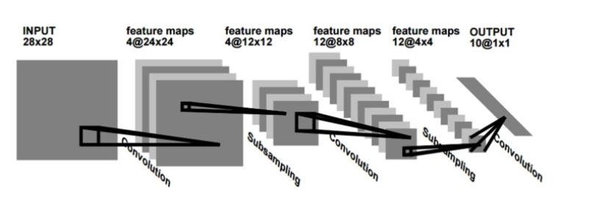
Convolution Neural Network - LeNet

Slide 33

Lab 0 : Environment

Slide 34
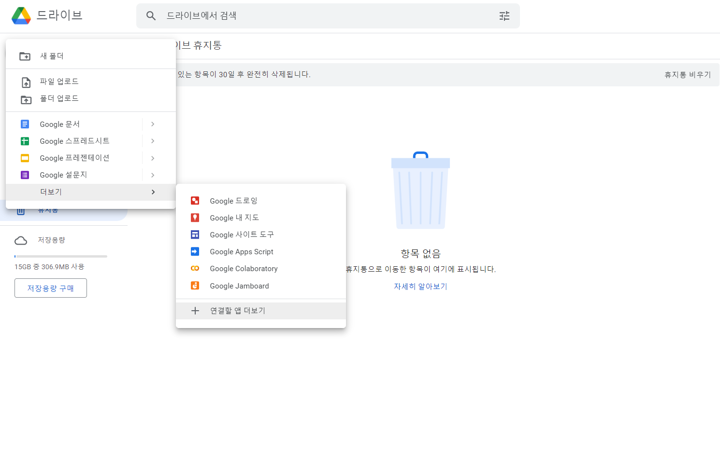
1. 구글 드라이브 -> 새로 만들기 -> 더 보기 -> 연결할 앱 더보기

Slide 35
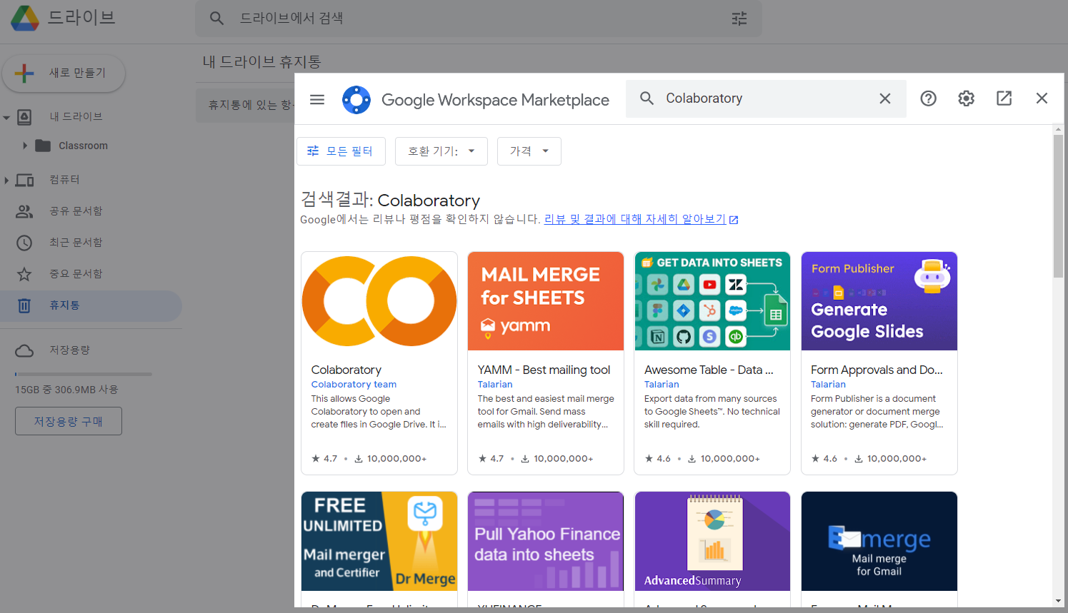
2. Colaboratory 검색 후 추가

Slide 36
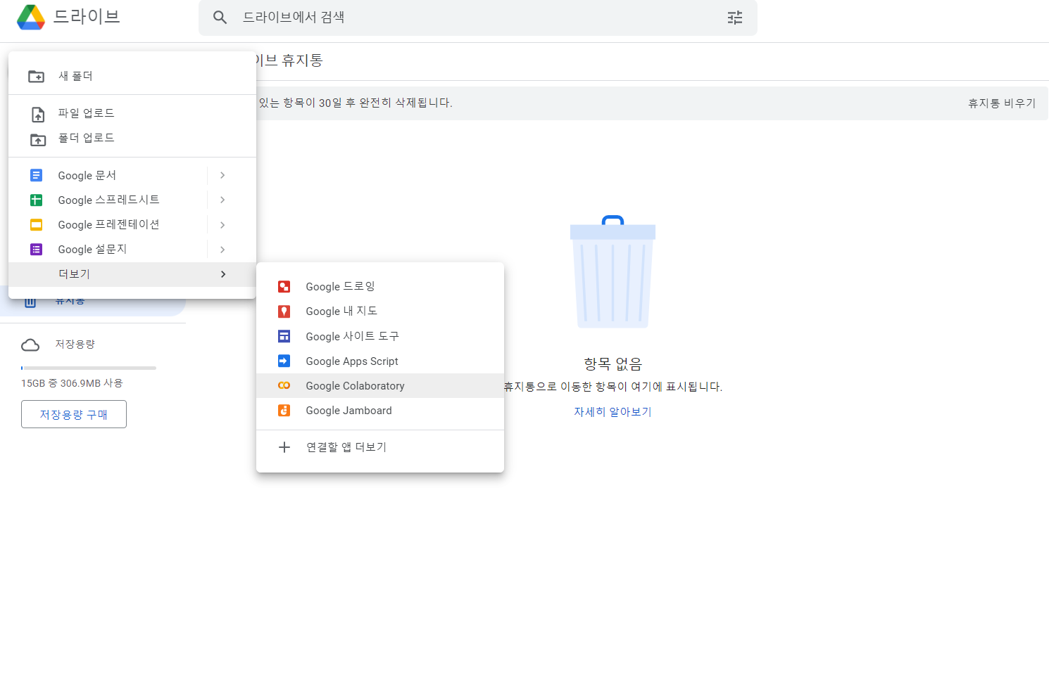
3. 구글 드라이브 -> 새로 만들기 -> 더 보기 -> Google Colaboratory

Slide 37
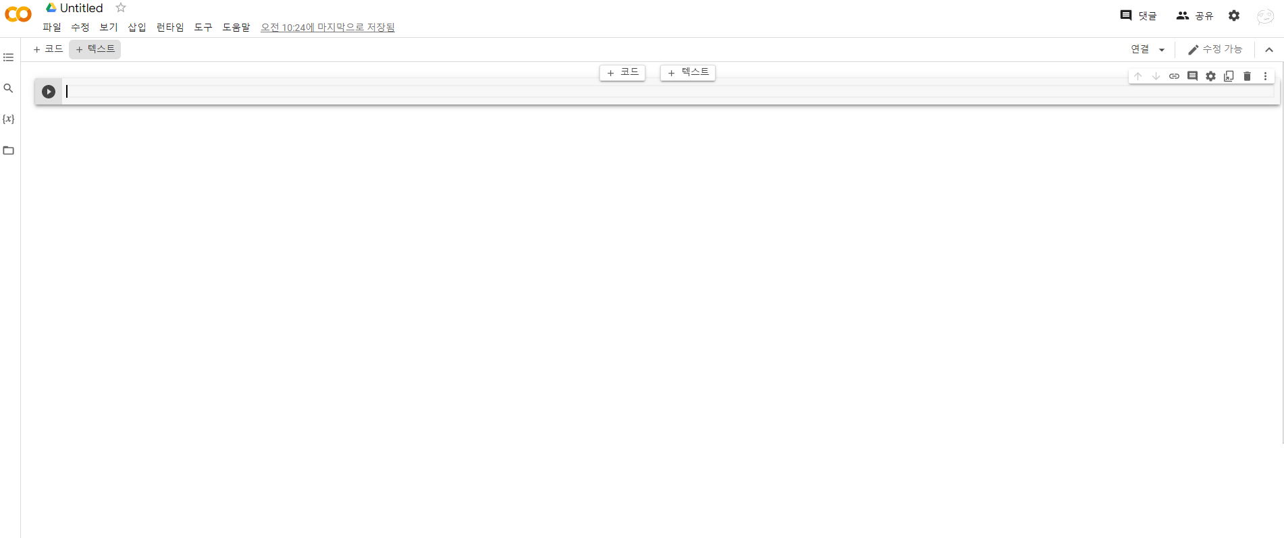
4. Google Colab 실행 완료

Slide 38
4. Google Colab 실행 완료

